Slide 1
WST
Week 02

Slide 2
Web Application Development
Is a client-server software application in which the client runs in a web browser. Common web application include email, online retail sales, online auctions, wikis and many others
Web Application Development is the creation of application programs that reside on remote servers and are delivered to the user's device over the Internet.
The creation of a Web Application usually involves one or more Developers

Slide 3
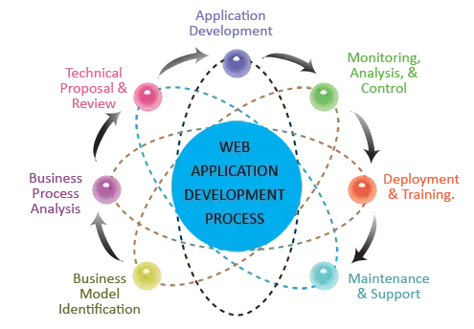
Web Application Development

Slide 4
HTML
Hypertext Markup Language (HTML) is the major markup language used to display web pages on the Internet. It is a standardized system for tagging text files to achieve font, colour, graphic, and hyperlink effects on World Wide Web pages.
HTML language consists of html tags

Slide 5
HTML Tags
Html tags are written in pairs
An opening tag and closing tag.
Some tags don’t have closing tag which we will discuss later.
HTML tags are element names surrounded by angle brackets.
First we have to give “<“ (less than) sign then keyword and “>” (greater than) sign and this is the opening tag e.g. <html>
To close a tag write “</” then tag name and then “>” e.g. </html>
In an html document there are three main tags <html>, <head> and <body>
<html> is the first and the last tag of the document
All other tags lie inside these tags

Slide 6
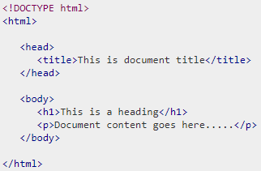
Simple HTML Document

Slide 7
Basic HTML Document Explained
The <!DOCTYPE html> declaration defines this document to be HTML.
The <html> element is the root element of an HTML page
The <head> element contains meta information about the document
The <title> element specifies a title for the document
The <body> element contains the visible page content
The <h1> element defines a large heading
The <p> element defines a paragraph

Slide 8
Web Browsers
The purpose of a web browser (Chrome, IE, Firefox, Safari) is to read HTML document and display them
The browser does not display the HTML tags, but uses them to determine how to display the document

Slide 9
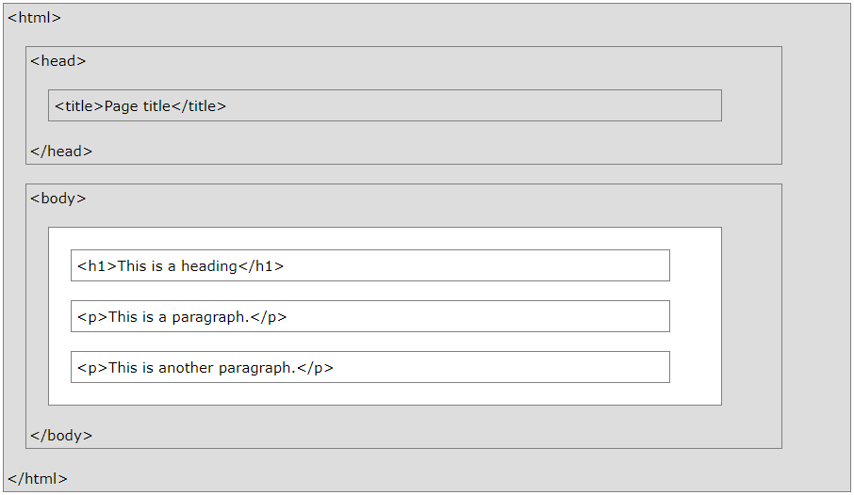
HTML Page Structure

Slide 10
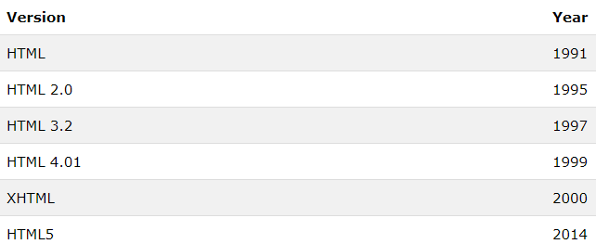
HTML Versions
Since the early days of the web, there have been many versions of HTML:

Slide 11

HTML Elements
An HTML element consists of a start tag and end tag, with the content inserted in between:
The HTML element is everything from the start tag to the end tag:
HTML elements with no content are called empty elements
<br> is an empty element without a closing tag. This tag defines a line break
Empty elements can be closed in the opening tag like this: <br />
HTML5 do not require empty elements to be closed
For XML parsers it is compulsory to close all HTML tags properly

Slide 12
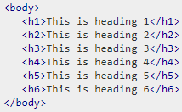
Heading Tags
Normally a document starts with a heading
We can use different sizes for headings
HTML has six levels of headings i.e. from <h1> to <h6>

Slide 13

Paragraph Tag
The <p> tag is used to structure text into different paragraphs
Each paragraph of text should go in between an opening <p> and a closing </p> tag as shown below in the example

Slide 14
Miscellaneous Tags
Line Break Tag
<br /> tag is used to insert a new line
This tag is an example of empty element, where we don’t need opening and closing tags
Center Tag
We can center contents using <center> tag
<center>
<p>This is testing</p>
</center>

Slide 15
Miscellaneous Tags
Horizontal Lines
Horizontal lines are used to visually break-up sections of a document
The <hr> tag create a line at current position
<hr /> tag is also an empty tag
Preserve Formatting
If we want our text to follow the exact format of how it is written in the HTML document we can use preformatted tag <pre>
Any text between the opening <pre> tag and the closing </pre> tag will preserve the formatting of the source document

Slide 16
HTML Attributes
Attributes provide additional information about HTML elements
All HTML elements can have attributes
Attributes are always specified in the start tag
Attributes usually come in name/value pairs like: name = “value”
The href Attribute
HTML links are defined with <a> tag. The link address is specified in the href attribute
<a href=“http://www.google.com”> click here to open Google </a>

Slide 17
HTML Attributes
We can also use “align” attribute with <p> tag as:
<p align=“left”> This is sample text </p>
<p align=“right”> This is sample text </p>
<p align=“center”> This is sample text </p>
Title attribute can also be used with paragraph or heading tags like:
<h3 title=“Hello HTML”>HTML is an easy language</h3>
It is often used to show tooltip text when cursor comes over the element

Slide 18
HTML Attributes
The src Attribute
HTML images are defined with <img> tag. The filename of the image source is specified in the src attribute
<img src=“banner.jpg”>
The width and height Attributes
We can specify width and height of images
<img src=“banner.jpg” width=“500” height=“600”>

Slide 19
HTML Attributes
The alt Attribute
The alt attribute specifies an alternative text to be used, when an image cannot be displayed
The value of the attribute can be read by screen readers. This way, someone "listening" to the webpage, e.g. a vision impaired person, can "hear" the element
<image src=“banner.jpg” alt=“banner with green background”>
The alt attribute is also useful if the image does not exist

Slide 20
HTML Attributes
The lang Attribute
The language of the document can be declared in the <html> tag
The language is declared with the lang attribute
Declaring a language is important for accessibility applications (screen readers) and search engines
<html lang=“en-US”>
Note: Most content have been taken from www.w3schools.com

Slide 21
HTML Attributes
Lowercase Attributes are recommended
The HTML5 standard does not require lowercase attribute names
W3C recommends lowercase in HTML, and demands lowercase for stricter document types like XHTML
Quote Attribute Values
The HTML5 standard does not require quotes around attribute values
<a href=http://www.google.com> [BAD]
<a href=“http://www.google.com”> [GOOD]
W3C recommends quotes in HTML and demands quotes for stricter documents like XHTML

Slide 22
HTML Attributes
Single or Double Quotes?
Double quotes around attribute values are the most common in HTML, but single quotes can also be used
In some situations, when the attribute value itself contains double quotes, it is necessary to use single quotes:
<p title=‘John “ShotGun” Nelson’>
<p title=“John ‘ShotGun’ Nelson”>

Slide 23
HTML Styles
The style attribute is used to specify the styling of an element, like color, font, size etc
The HTML style attribute has the following syntax
<tagname style=“property:value”;> contents goes here …</tagname>
The property is CSS property. Th value is a CSS value
<p style=“color:red”>We study in UOG”</p>
<body style=“background-color:#FF00FF;”>
<body style=“background-color:rgb(180,180,180); color:white”>
This technique is called inline styles

Slide 24
HTML Styles
HTML Background Color
The background-color property defines the background color of an HTML element
<body style="background-color:powderblue;">
</body>
HTML Text Color
The color property defines the text color for an HTML element
<p style="color:red;">This is a paragraph.</p>
For more information on colors please visit the link below:
https://www.w3schools.com/html/html_colors.asp

Slide 25
HTML Styles
HTML Fonts
The “font-family” property defines the font to be used for an HTML element
<h1 style="font-family:verdana;">This is a heading</h1>
HTML Text Size
The “font-size” property defines the text size for an HTML element
<h1 style="font-size:300%;">This is a heading</h1>
HTML Text Alignment
The “text-align” property defines the horizontal text alignment
<p style="text-align:center;">Centered paragraph.</p>

Slide 26
HTML Formatting Elements
HTML <b> and <strong> Elements
The HTML <b> element defines bold text, without any extra importance
The HTML <strong> element defines strong text, with added semantic “strong” importance
HTML <i> and <em> Elements
The HTML <i> element defines italic text, without any extra importance
The HTML <em> element defines emphasized text , with added semantic importance

Slide 27
HTML Formatting Elements
HTML <small> Element
The HTML <small> element defines smaller text
<h2>HTML <small>Small</small> Formatting</h2>
HTML <big> Element
The text within <big> tag is displayed one font size larger than normal font
<h2>HTML <big>Big</big> Formatting</h2>
HTML <mark> Element
The HTML <mark> element defines marked or highlighted text
<h2>HTML <mark>Marked</mark> Formatting</h2>

Slide 28
HTML Formatting Elements
HTML <del> and <strike> Element
The HTML <del> element defines deleted (removed) text whereas text within <strike> tag displayed with strikethrough
<p>My favorite color is <del>blue</del> red.</p>
<p>This text is <strike>strikethrough</strike></p>
HTML <ins> and <u> Element
The HTML <ins> element defines inserted (added) text whereas text within <u> tag displayed with underline
<p>My favorite <ins>color</ins> is red.</p>
<p>This is <u>underline</u> text.</p>

Slide 29
HTML Formatting Elements
HTML <sub> Element
The HTML <sub> element defines subscripted text
<p>This is <sub>subscripted</sub> text.</p>
HTML <sup> Element
The HTML <sup> element defines superscripted text
<p>This is <sup>superscripted</sup> text.</p>

Slide 30
HTML Comments
We can add comments to our code by using the following syntax
<!-- Write your comments here -->
Comments are not displayed by the browser, but they can help document our HTML source code
Border Color
We can set the color of borders:
<h1 style="border:2px solid Tomato;">Hello World</h1>
Block level elements consumes entire width and always start with a new line
Div, p, form, h1 to h6
Inline elements don’t take entire width and don’t start with a new line
Span, a, img

Slide 31

Grouping Content
The <div> element allows us to group together several elements to create sections or subsections of a page
For example, you might want to put all of the footnotes on a page within a <div> element to indicate that all of the elements within that <div> element relate to the footnotes. You might then attach a style to this <div> element so that they appear using a special set of style rules

Slide 32
Example
<!DOCTYPE html> <html> <head> <title>Page Title</title> </head> <body> <h1>This is a Heading</h1> <p>This is a paragraph.</p> </body> </html>

